Slide 1
EGR7040-Final Project
Thrust optimized SLA 3D printed compressed air rocket
Jack Young

Slide 2
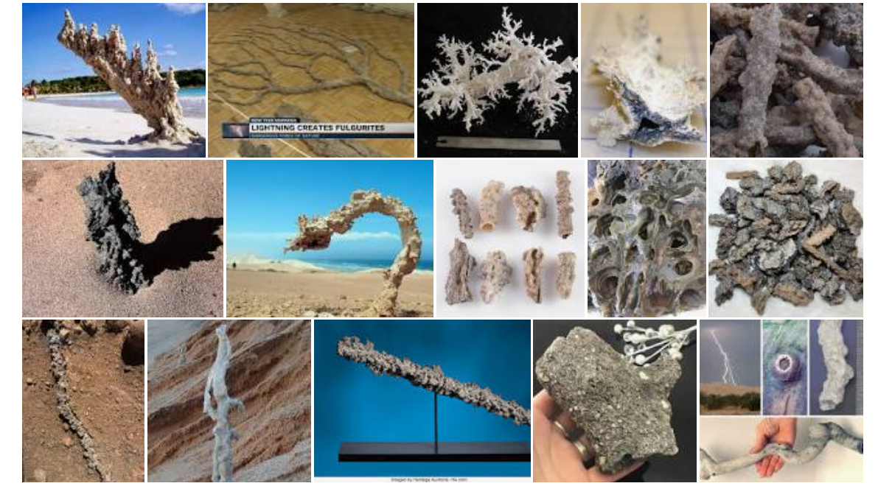
Fulgurite Project Goal
• What is a fulgurite?

Slide 3
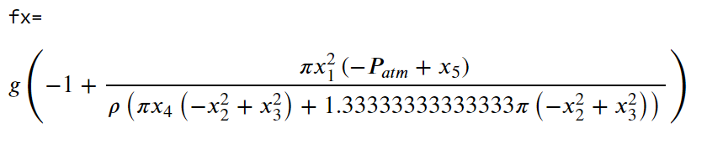
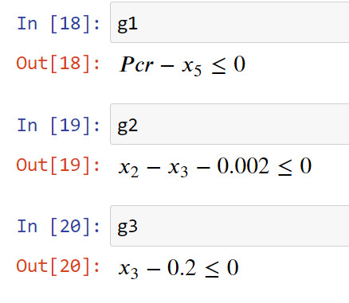
Candidate Design Problem
Maximize acceleration from equation
Subject to constraints:

Slide 4
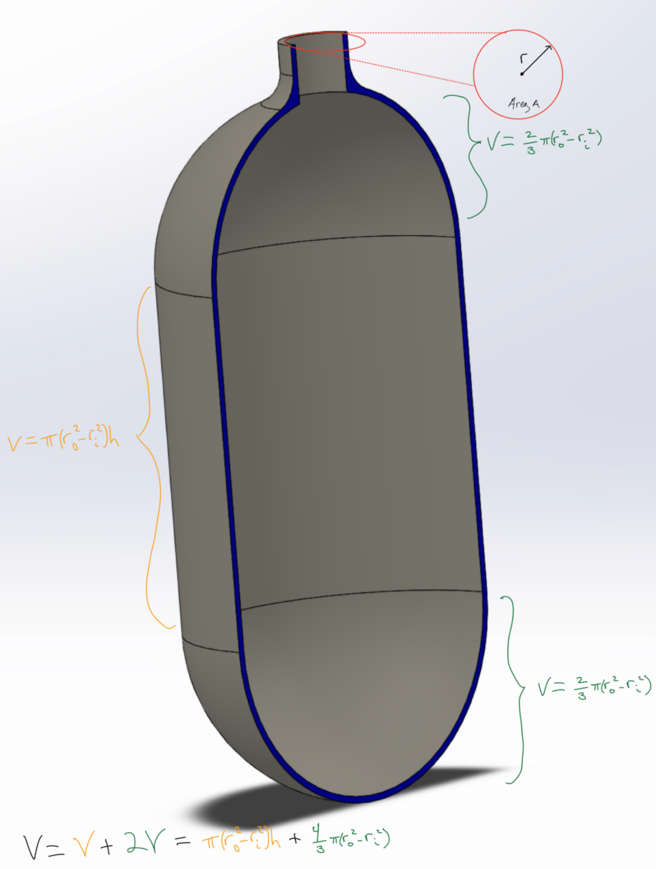
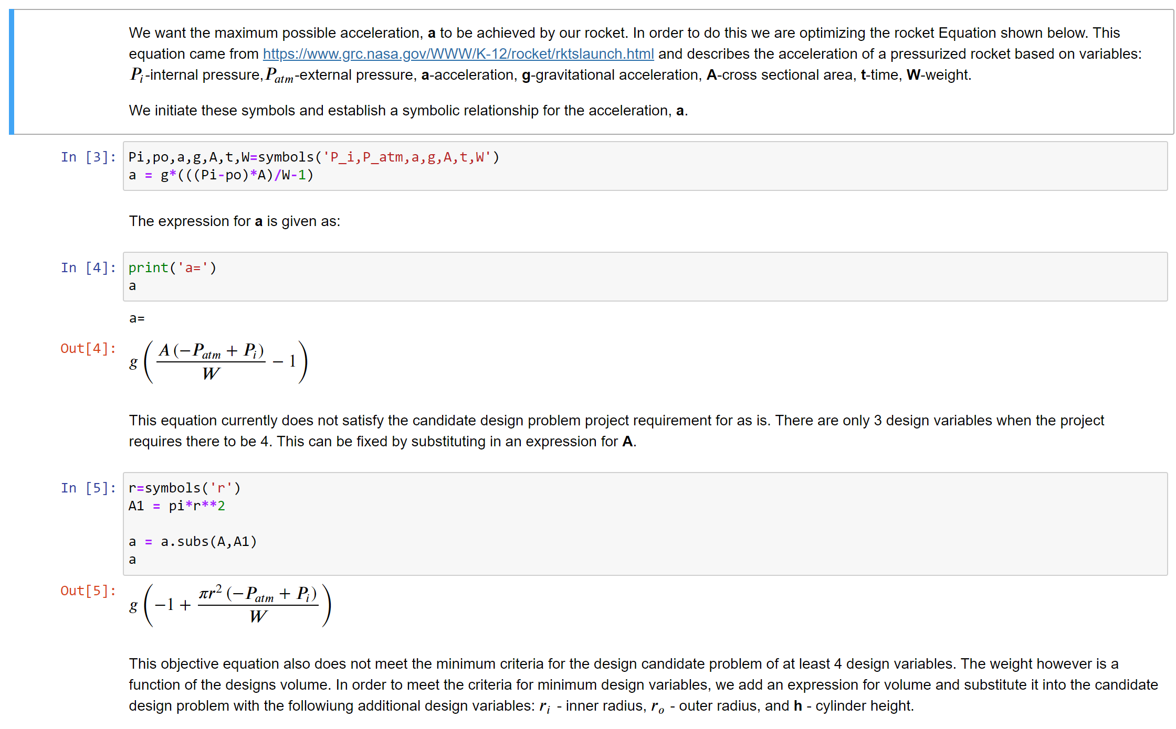
Compressed air rocket design problem formulation

Slide 5
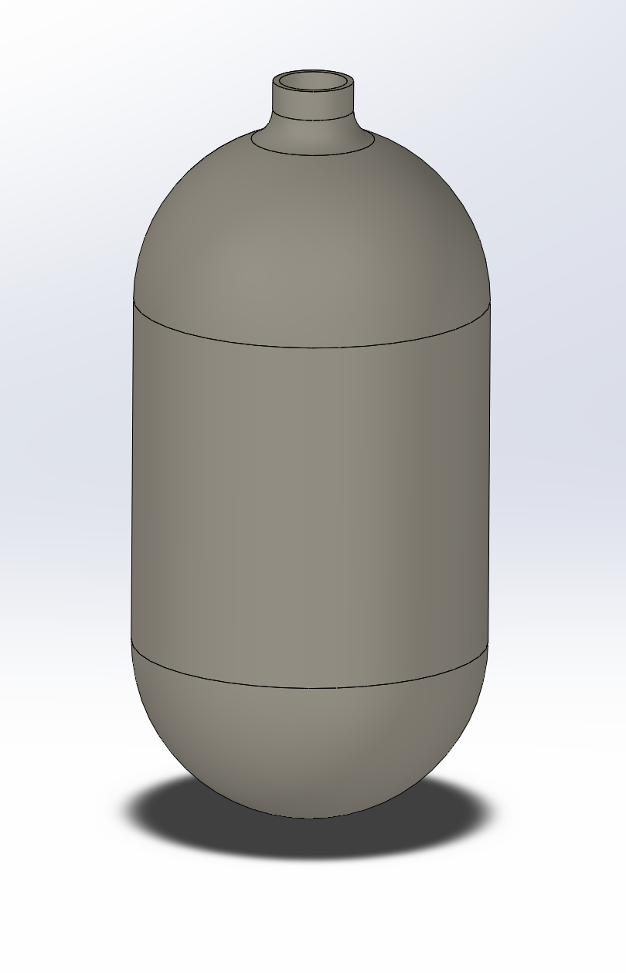
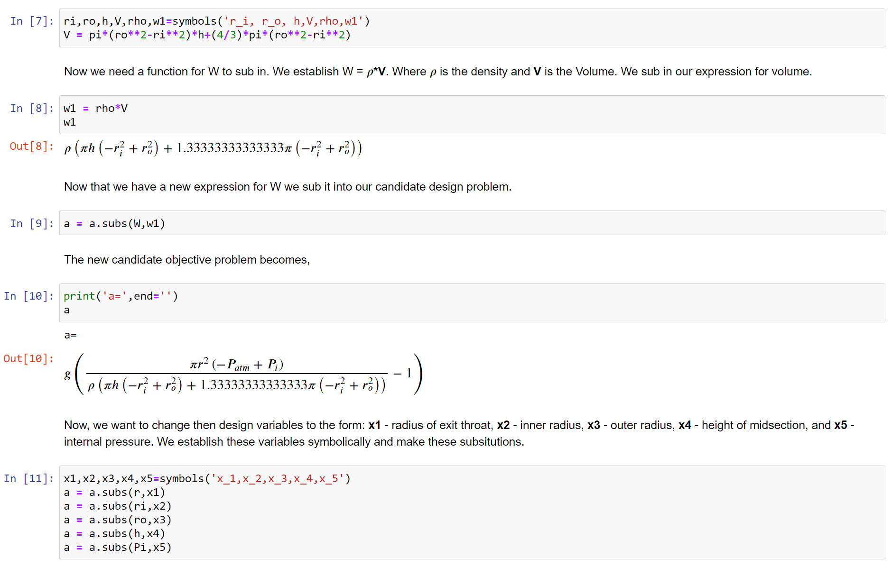
Compressed air rocket design problem formulation

Slide 6
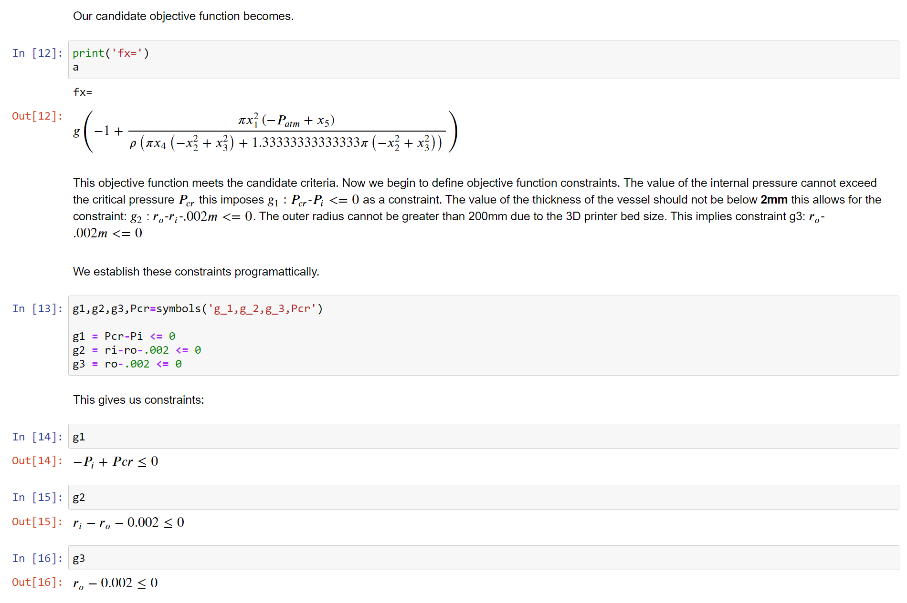
Compressed air rocket design problem formulation

Slide 7
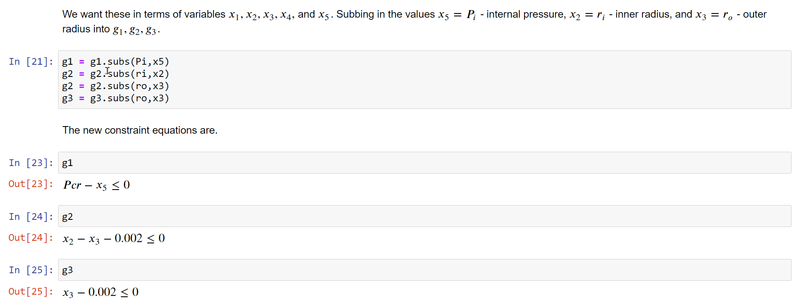
Compressed air rocket design problem formulation

Slide 8
Candidate Design Problem
Maximize acceleration from equation
Subject to constraints:

Slide 9
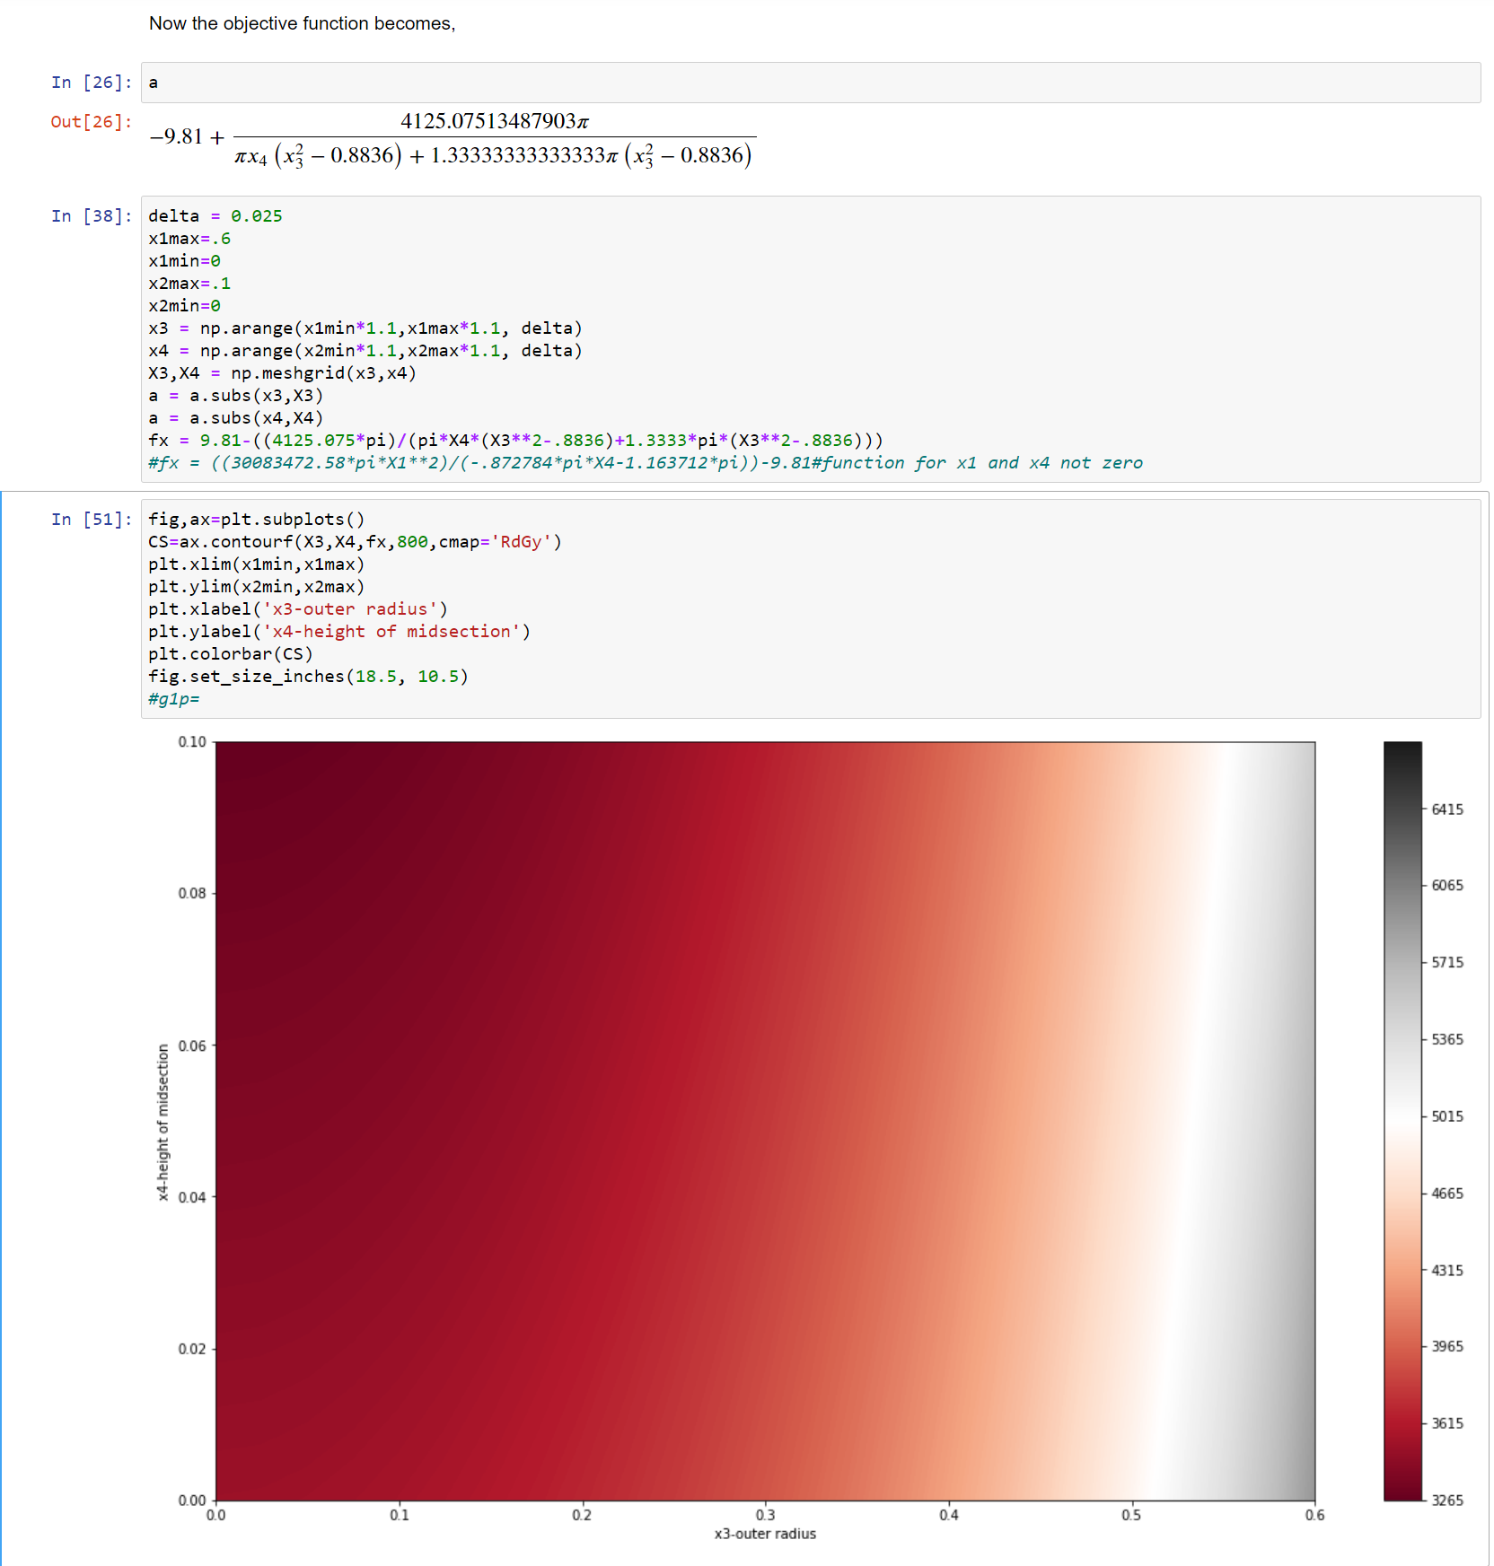
Objective Function shown graphically in 2D
Acceleration increases as radius of
rocket decreases, this means there is a
math error that needs to be found still
at this stage.
Acceleration is also too high a unit
analysis and code reread is needed

Slide 10
Cost
Cost is neglected currently but is tied to the print time and the weight function

Slide 11
Questions?

